Slide 1
Status Update for RTT Positioning Trial
03/11/2020
Location
@qualcomm

Slide 2
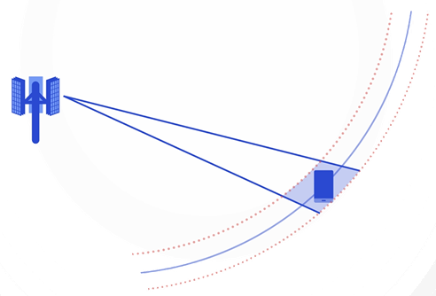
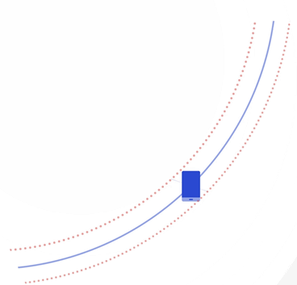


Phased Trial Plan
Single Cell RTT + AoA (Done)
  Round Trip Time (RTT) estimation determines range
  Massive MIMO based Angle-of-Arrival (AoA) estimation determines position within that range
P1a: Single-cell RTT + AoA in campus network
Multi-cell RTT + AoA (Ongoing)
    Additional LOS gNBs improve positioning accuracy
    Tight time synchronization not required
P1b: Multi-cell RTT + AoA in campus network
  P2: Multi-cell RTT + AoA in realistic deployment

Slide 3
Summary of P1a 5G Positioning Trial
P1a：Single Cell RTT + AoA
Demo Video：https://www.qualcomm.com/videos/5g-single-cell-positioning-ota-demonstration
Joint field trial results
Raw* positioning accuracy along trail route
 | 50th percentile | 80th percentile
Horizontal Accuracy | 1.6m | 2.1m
Vertical Accuracy | 0.8m | 1.2m
*Instantaneous location estimates with no temporal processing, no GNSS or other sensor data assistance
Multi-cell RTT / AoA based implementation is expected to improve accuracy

Slide 4
Appendix

Slide 5

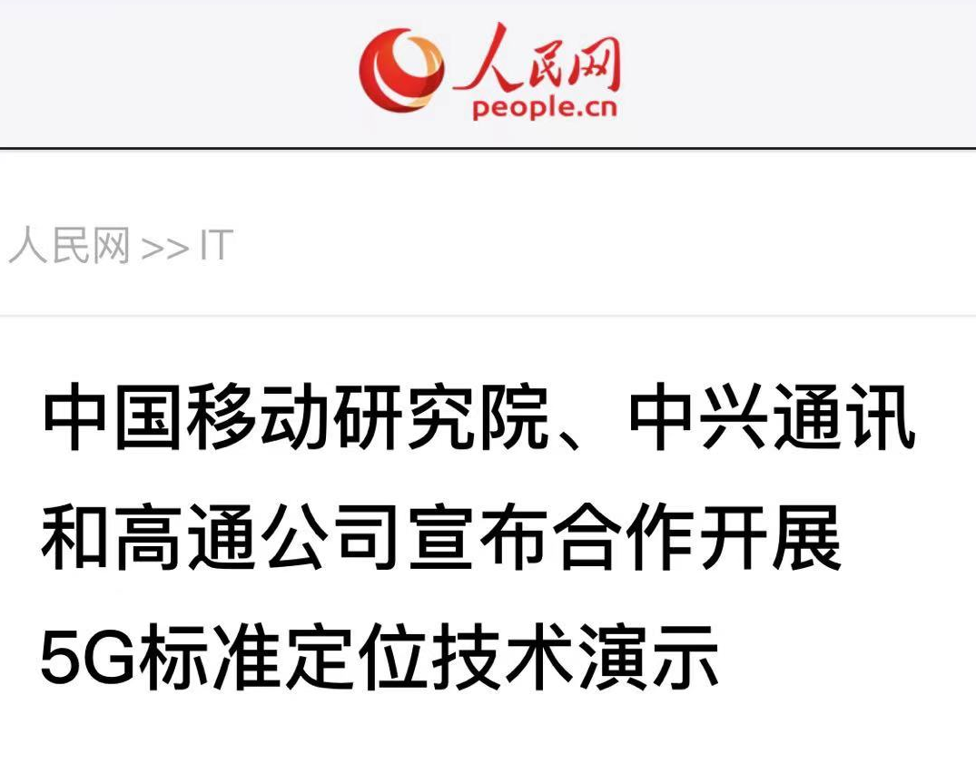

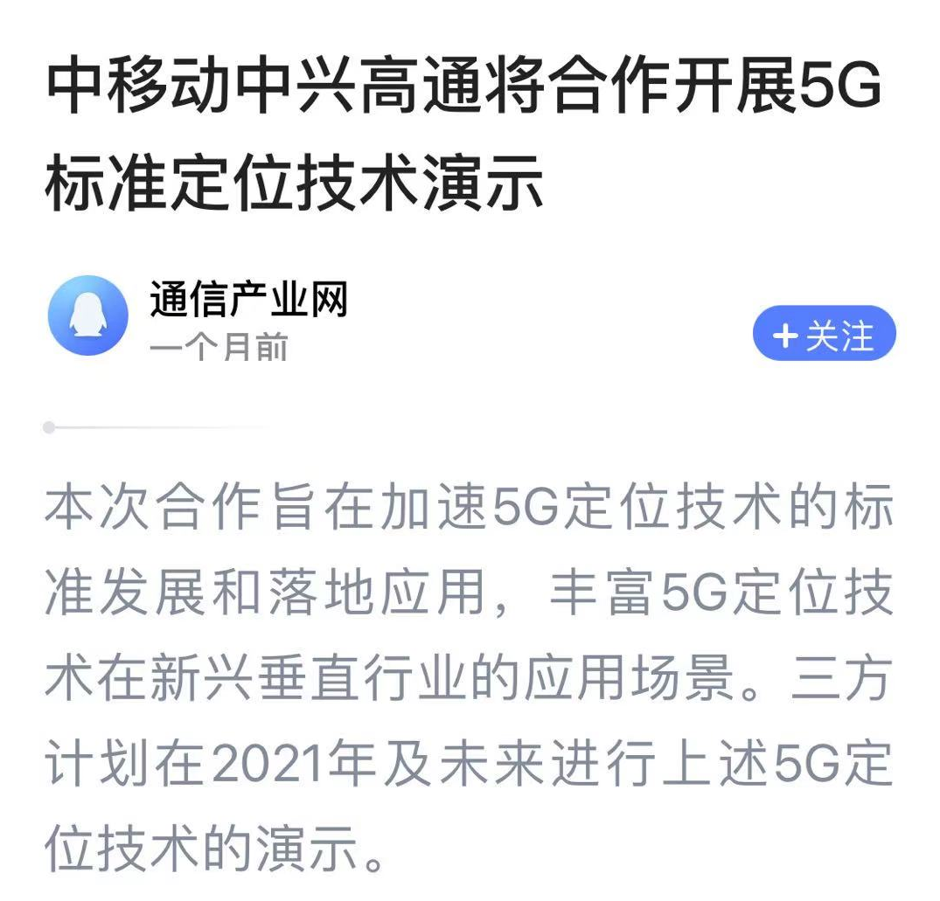
Achieved Milestone for 5G RTT Positioning
P1：Single Cell + AoA
Online live positioning demo for CMRI
  Dec. 28th , 2020
Trilateral PR release:
  Feb. 5th, 2021
MWC-S demo
  Feb. 23rd ~25th , 2021

Slide 6
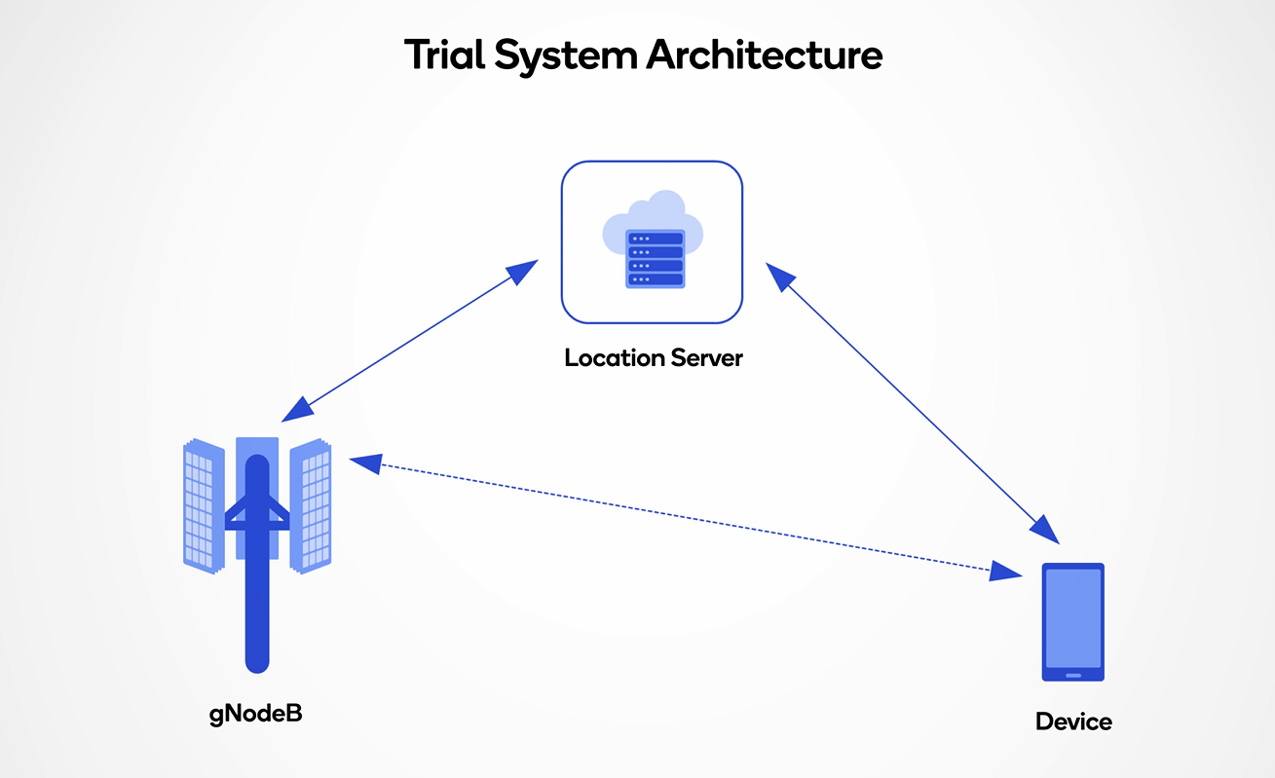
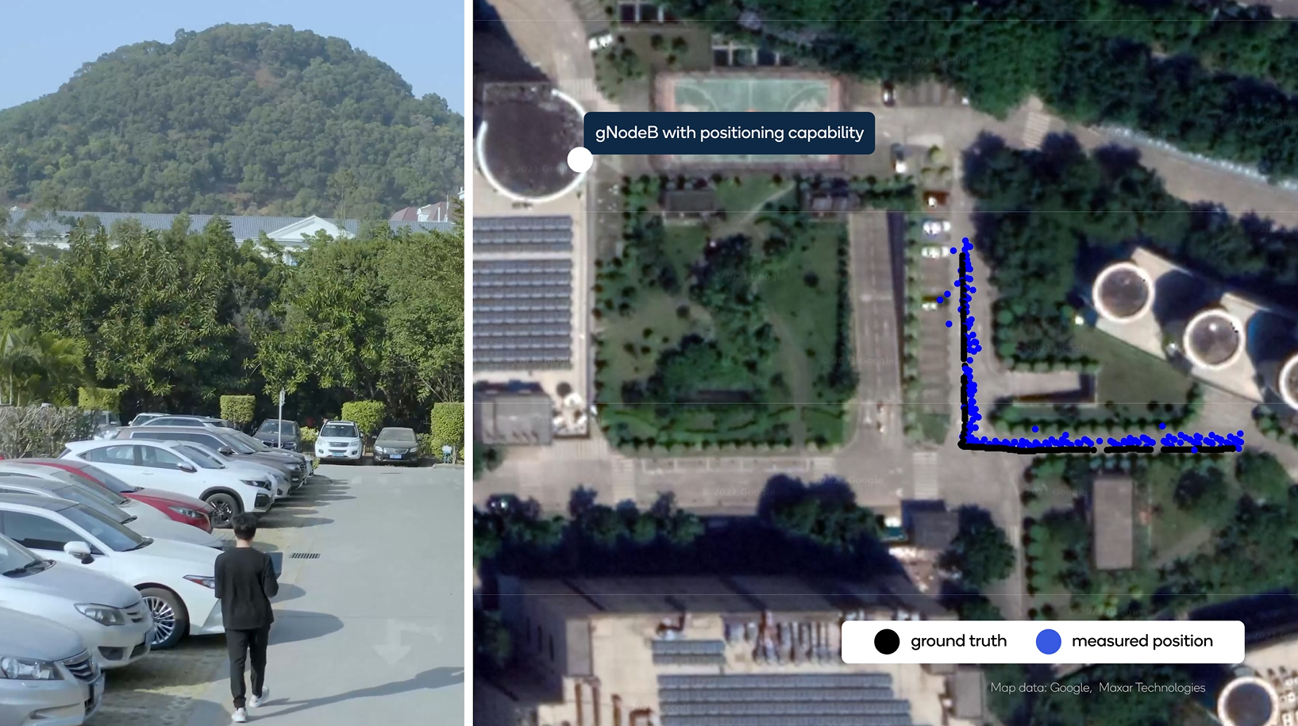
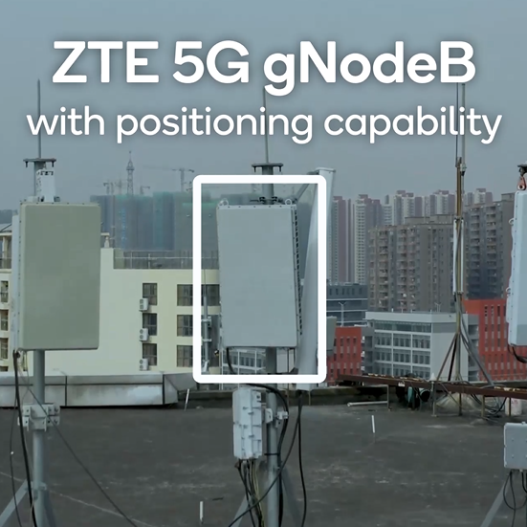
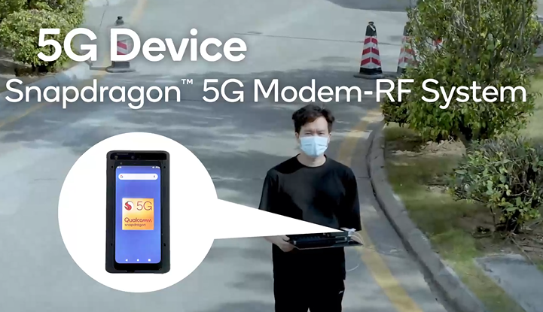
P1 Setup of 5G Positioning Trial
P1：Single Cell + AoA
SA mode with 100 MHz @n41
gNB: ZTE 64 TxRUs (38 meters above ground)
MTP: Snapdragon X55
Location server: designed and operated by QC in Beijing
90 meters
150 meters

